Slide 1
Top Down Design
Notes:
Hi, in this video we’re going to learn about how we can use Top Down Design to break large problems into more manageable pieces. Let’s get started!

Slide 2
Writing Better Programs
We’ve learned how to use functions and for loops in our code to:
Break our programs into smaller parts
Avoid repeating code
Make our code more readable
But sometimes the problems we’re being asked to solve are still very large.
Notes:
We’ve learned how to use functions and for loops to make our code easier to read and follow but sometimes we’re being asked to solve problems that are so large, we don’t know where to start.

Slide 3
What About BIG Problems?
As we start solving more and more complex problems, our code is going to get even more complicated.
This is when why we need to use
Top Down Design.
Notes:
Some of the challenges we are given may require us to do a multitude of things and it can make it difficult to decide where to start. That’s when Top Down Design is going to be really useful.

Slide 4
What is Top Down Design?
Large Problem
Host Thanksgiving Dinner
Notes:
So what is Top Down Design? Well let’s say we’re given a really large problem, something like hosting Thanksgiving dinner. This is too big a challenge to tackle all at once, so we can break it up into its different parts.

Slide 5
What is Top Down Design?
Large Problem
Host Thanksgiving Dinner
Smaller Problem
Guests
Smaller Problem
Food
Smaller Problem
Logistics
Notes:
We can think of some smaller problems that compose the larger one. Some things we’d need to tackle to get Thanksgiving dinner in order would be the guests, food, and logistics.

Slide 6
What is Top Down Design?
Large Problem
Host Thanksgiving Dinner
Smaller Problem
Guests
Smaller Problem
Food
Smaller Problem
Logistics
Smaller Problem
Who?
Smaller Problem
Invites
Smaller Problem
Shop
Smaller Problem
Cook
Smaller Problem
Time
Smaller Problem
Space
Notes:
We can then break each smaller problem down even further until we find some manageable tasks, such as who to invite to Thanksgiving, what we need to buy, and what time to tell the guests to arrive.
Once we get to some tasks we can tackle, we can start solving the smaller pieces of the puzzle that will add together to solve the larger one we were given. Let’s see how Top Down Design can help us solve a complicated coding problem.

Slide 7
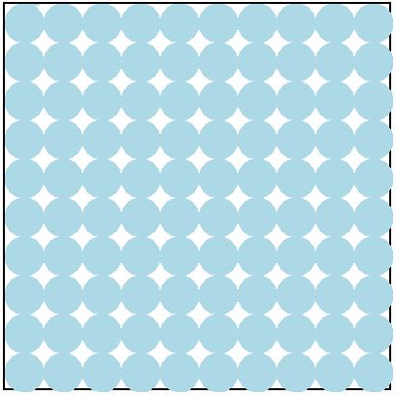
Example #1: Bubble Wrap
Write a program that has Tracy fill the canvas with 10 rows and 10 columns of blue circles to simulate bubble wrap.
Notes:
In this example, we are asked to write a program that will fill our canvas with 10 rows and 10 columns of light blue circles. This may seem like an overwhelming challenge but we can use Top Down Design to break it into smaller, more manageable parts.

Slide 8
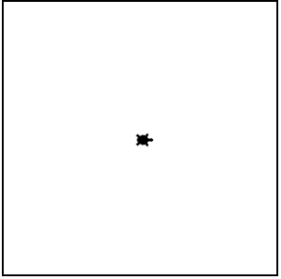
Example #1: Bubble Wrap
Big Problem:
Draw 10 Rows of 10 Circles
Smaller Problem:
Draw Row of 10 Circles
Even Smaller Problem:
Draw 1 Circle
Notes:
The first thing we want to do is break this big problem up into smaller pieces. Our big problem is to draw 10 rows of 10 circles. A smaller problem that will help us solve the larger one (click for text) is to draw one row of 10 circles. And an even smaller problem encased in that problem (click for text) is to draw 1 circle. With this in mind, let’s write some pseudocode to help us plan our program.

Slide 9
Example #1: Bubble Wrap
Move Tracy to starting position
Notes:
The first thing we want to do is have Tracy move to the starting position in the bottom left hand corner of the screen.

Slide 10
Example #1: Bubble Wrap
Move Tracy to starting position
Draw one circle
Notes:
Then we want Tracy to draw a circle.

Slide 11
Example #1: Bubble Wrap
Move Tracy to starting position
Draw a row of circles:
Repeat 10 times:
Draw one circle
Move forward
Notes:
In order to draw the whole row of circles, she’s going to need to (click for text) move forward after drawing each circle and then (click for text) repeat this whole process 10 times.

Slide 12
Example #1: Bubble Wrap
Move Tracy to starting position
Draw a row of circles:
Repeat 10 times:
Draw one circle
Move forward
Move to top of next row
Notes:
Once she’s drawn one row, we need her to move back to the top of the next row.

Slide 13
Example #1: Bubble Wrap
Move Tracy to starting position
Repeat 10 times:
Draw a row of 10 circles:
Repeat 10 times:
Draw one circle
Move forward
Move to top of next row
Notes:
In order to fill the whole canvas, we need to repeat this whole process 10 times. Now that we have our pseudocode, we can start writing code to solve each part of this process.

Slide 14
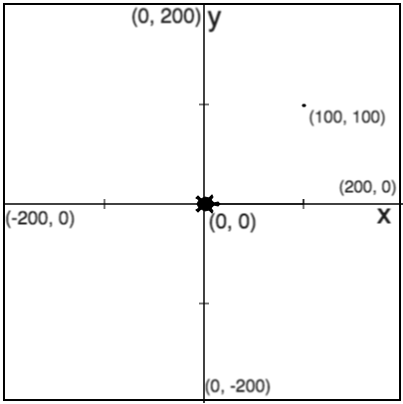
Example #1: Bubble Wrap
Smaller Problem:
Draw One Circle
def draw_circle():
pendown()
begin_fill()
color(“light blue”)
circle(20)
end_fill()
penup()
forward(40)
Notes:
The first thing we want to teach Tracy to do is draw one of our light blue circles. Since we know we’re going to be repeating this, (Click for yellow box and label) let’s go ahead and make a function called draw_circle.
We’ve already written code that will draw a circle filled in with a specific color, so this isn’t a hard problem for us. (Click for function commands) We’ll tell Tracy to draw a light blue circle and then move forward the diameter, which in this case is 40. See, that wasn’t a hard problem to solve!

Slide 15
Example #1: Bubble Wrap
Smaller Problem:
Draw Row of Ten Circles
def draw_circle_row():
for i in range(10):
pendown()
begin_fill()
color(“light blue”)
circle(20)
end_fill()
penup()
forward(40)
Notes:
Next, we want to take that one circle that Tracy drew and draw 10 of them in a row across the width of our canvas but this won’t trick us either because we know how to use loops!
(Click for yellow box and label) We can just initialize our loop before Tracy starts drawing the circle and fill in 10 for the amount of times to repeat.
You’ll also notice that we changed the name of this functions to draw_circle_row because we are now drawing all 10 circles.

Slide 16
Example #1: Bubble Wrap
Smaller Problem:
Move Tracy up to Next Row
def move_up_a_row():
left(90)
forward(40)
right(90)
backward(400)
Notes:
Another smaller problem we can solve is moving Tracy from her end point after drawing 10 circles to the top of the next row where she needs to start drawing 10 more circles. (Click for yellow box and label) We can write a function to solve this problem.
Tracy ended 20 pixels past the right side of the canvas after drawing the last circle because she moved forward 40 pixels at the end of the loop. She also ended facing right. To get her to to the top of the circle row, (Click for first commands in function) we need her to turn left(90) so she’s facing up and then go forward 40 pixels because that is the diameter of my circle.
After she gets to the top, I will (Click for second commands in function) have Tracy turn right(90) so she’s facing right and then move her backward(400) to get to the left side of the canvas.

Slide 17
Example #1: Bubble Wrap
Now put all pieces together to solve the large problem!
Move Tracy to Start Position
def draw_circle_row():
def move_up_a_row():
x 10
Notes:
I’ve now solved each part of my code so all I need to do is put the pieces together! I want Tracy to draw a row of circles and then move to the next row 10 times. Let’s put this in our code editor and see if it works!

Slide 18
Topics Learned this Lesson
Topic | What does it do?
Top Down Design | Breaks a large problem into smaller, more manageable parts to make it easier to find a solution
Notes:
In this lesson, we learned how to use Top Down Design to break large problems into smaller pieces so they’re easier to solve. Use Top Down Design to solve the next Tracy challenges!

